Slide 1
Developments in Defamation Law 2023
National Newspaper Association Convention
Washington, DC
Matthew E. Kelley
Of Counsel, Media & Entertainment Group
Washington, DC & Phoenix, AZ
kelleym@ballardspahr.com

Slide 2
Developments in Defamation Law
In this presentation, we’ll discuss:
  Defamation Law Refresher
  Recent Developments in Defamation Law
    Dominion Voting Systems v. Fox News
    Increase in Ideological Defamation Litigation
    The Death of New York Times v. Sullivan?
  Your Questions

Slide 3
Defamation 101
What it is, what it isn’t, and how to mitigate the risks

Slide 4
What Is Defamation?
A published statement of fact (capable of verification)
That is defamatory (i.e., harmful to reputation)
That is about the plaintiff (“of and concerning”)
That is materially false
Without any legal privilege
With fault
Causing injury to the plaintiff

Slide 5
Tips for reducing defamation risk
Tip #1: Be Aware of Implications:
Defamation by implication: In some circumstances, the reasonably understood (but unstated) implications of a statement may be actionable as defamation.
Defamation by implication claims can arise from:
  Juxtaposition of photos with text
  Arrangement of words
  Omission of material point
  Suggestive section headings

Slide 6
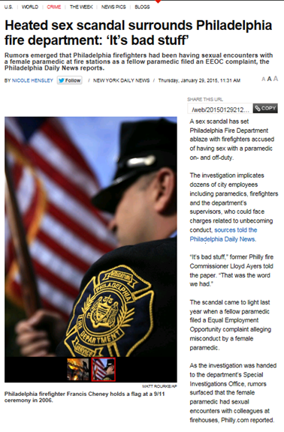
Cheney v. Daily News L.P., 654 F. App’x 578 (3d Cir. 2016)
Implications

Slide 7
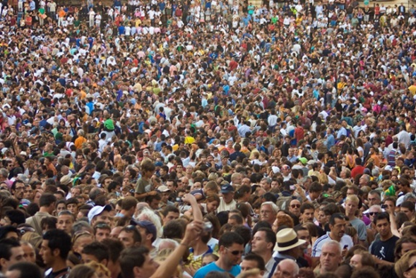
Tips for Avoiding Implication Claims
Watch for juxtapositions.
Review reports that include all elements – including promotional materials and photographs. Look for potential implications in context.
Review reports about groups, where broad statements are made or categories of people. Are all potentially defamatory statements applicable to all identified or identifiable people or entities? If not, is that clear?

Slide 8

Tips for reducing defamation risk
Tip #2: Watch out for minor characters
The main subject of a report is not the only one who can assert a claim for defamation.
Pay attention to anyone or any entity that may be “identifiable.”

Slide 9
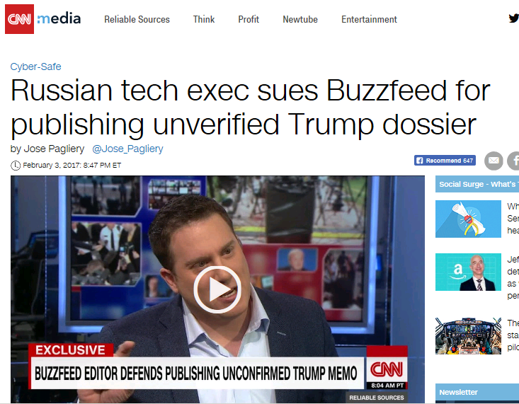

Slide 10
Tips for reducing defamation risk
Tip #3: Take retraction demands seriously
Someone who feels wronged by a report is likely to be further enraged – and more willing to sue – if they feel ignored

Slide 11
Tips for reducing defamation risk
Tip #4: Use the fair report privilege to your advantage
This privilege allows reporting on governmental actions, proceedings, and documents even if the information contained in the official records is wrong.
The precise contours of the privilege vary by state.

Slide 12

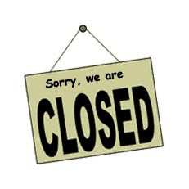
Fair Report Privilege – Caveats
Foreign official records
may not be covered
Sealed or closed proceedings may not be covered (depending on the state)
“We usually extend the privilege because of the nature of the relationship we share with our own government. We are familiar with the workings of our government and consider it to be open and reliable. We can also hold our own government accountable for its actions. Foreign governments, like nongovernmental sources of information, are not necessarily familiar, open, reliable, or accountable. Therefore, we think it unwise to provide a blanket privilege to those who report the activities of foreign governments.”
order’ lie outside the fair-report privilege” because “a court has decided that certain sensitive but gossipy matters should remain confidential in order to properly protect reputation.”
Fortenbaugh v. New Jersey Press, Inc., 722 A.2d 568 (N.J. Super. Ct. 1999)
But in Massachusetts, “the privilege also covers proceedings and actions taken out of public view so long as they are official,” on a “public supervision” theory.
Howell v. Enterprise Publishing Co., 920 N.E.2d 1
(Mass. 2010)
Lee v. Dong-A Ilbo, 849 F.2d 876 (4th Cir. 1988)

Slide 13
Fair Report Privilege - Requirements
The privilege requires:
  Attribution to official proceeding/record
  Substantially fair and accurate summary of proceeding

Slide 14
Recent Developments
The Fox News settlement and more

Slide 15
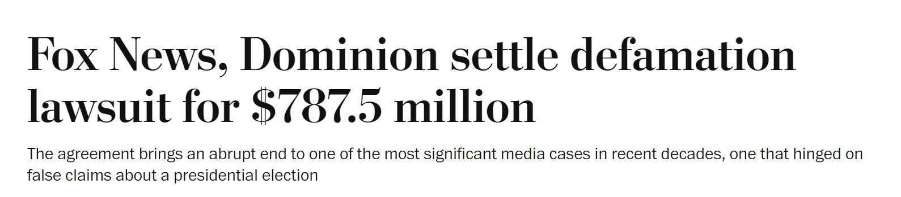
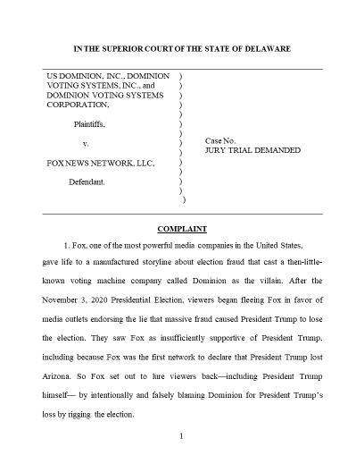
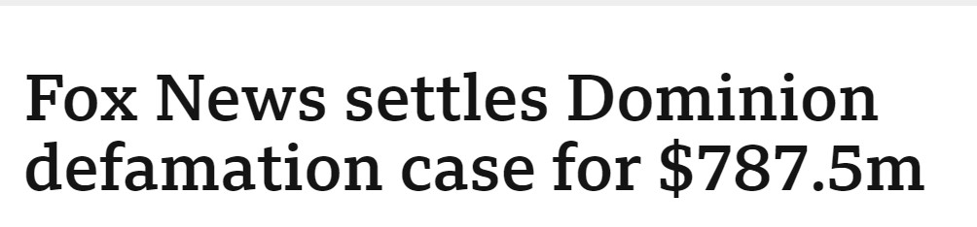
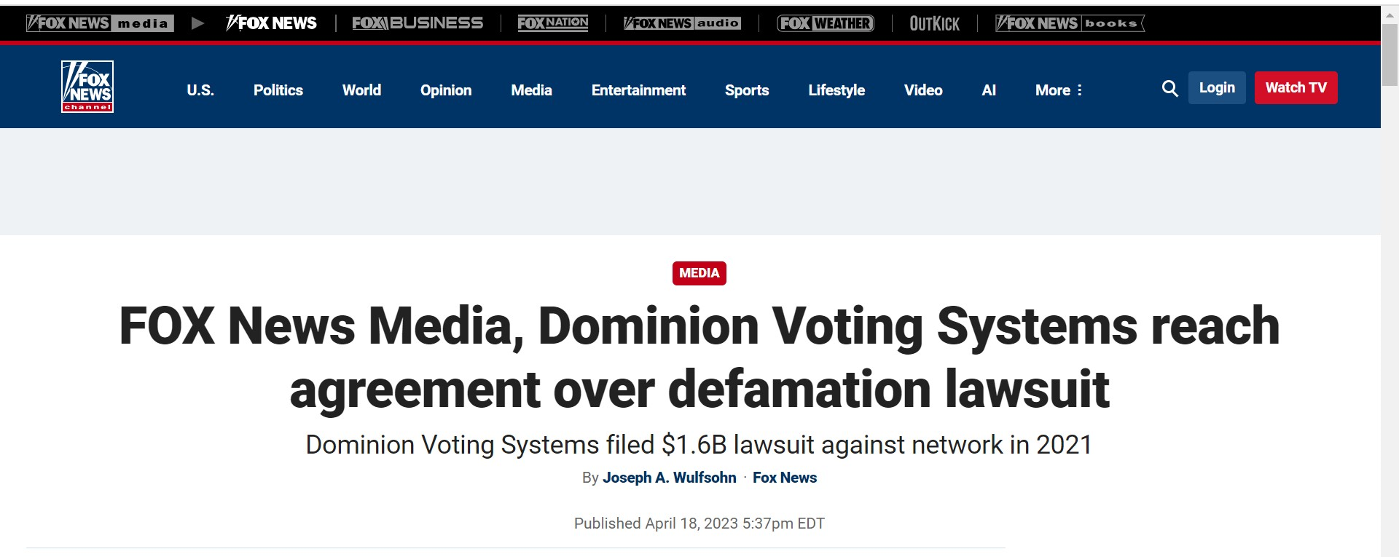
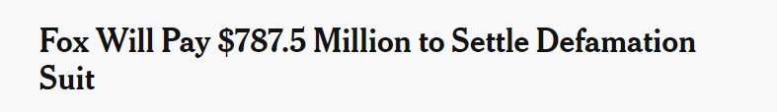
Dominion Voting Systems v. Fox News

Slide 16


The Fox Settlement
Likely the largest payout in a defamation case
Court had ruled several statements were false
Documents released in discovery embarrassed the network and indicated knowledge of falsity
  This was an unusual for a media defamation case

Slide 17

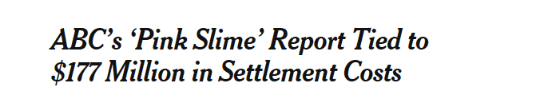


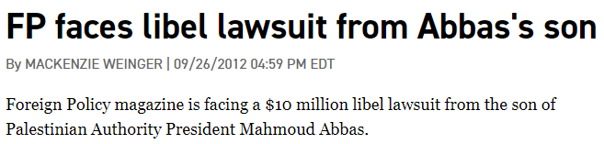

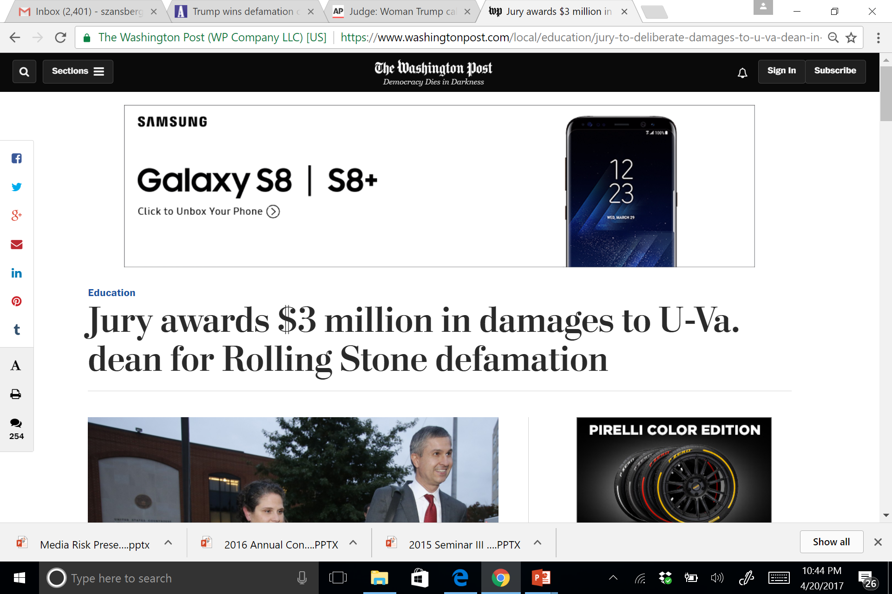
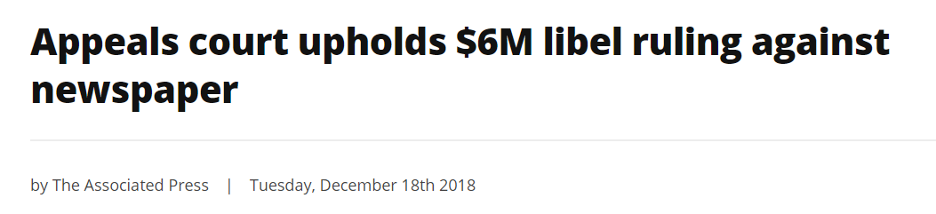

Slide 18
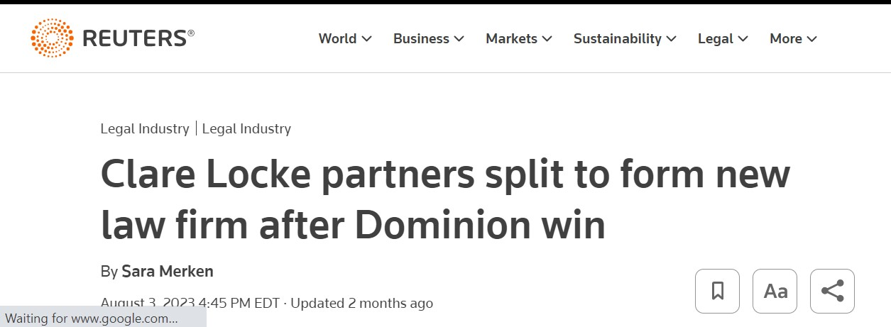
What does this mean?
Legally, the Fox case did not set precedent
Several similar lawsuits remain pending
Whether the Fox settlement will encourage more defamation litigation is yet to be seen . . .
But it did enrich some plaintiffs’ side defamation lawyers

Slide 19
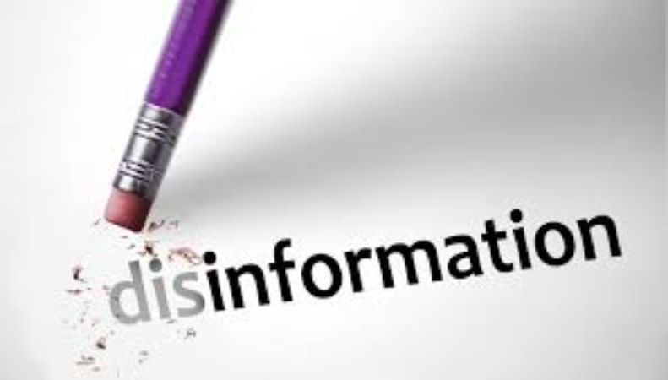
Defamation and Disinformation
Plaintiffs say the Dominion v. Fox and similar cases are intended to combat disinformation
But an increasing number of defamation lawsuits are driven by ideology
Some appear to be meant to legitimize disinformation rather than combat it

Slide 20
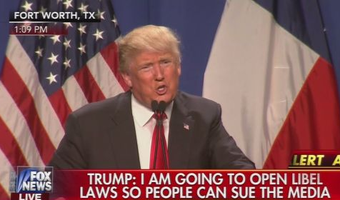
The Rise of Ideological Defamation Lawsuits
The Media Law Resource Center has tracked a surge in defamation litigation since 2015
One major
reason:

Slide 21
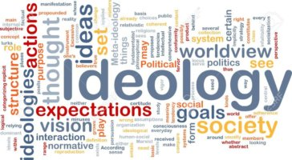
Ideological Defamation Plaintiffs
Ideological libel suits are often brought by:
  Politicians
  Media commentators and social media influencers
  Conspiracy theorists
  Activists
  Ideological organizations

Slide 22
Problems with ideological lawsuits
Ideologically driven lawsuits are problematic:
  The point is not to win and recover money; it is to harass perceived enemies via litigation
  The lawsuit can be a fundraising vehicle, diminishing the incentive to settle and lowering the deterrent value of fee awards for frivolous litigation
  The legal system assumes bad-faith litigation is the rare exception and is thus ill-equipped to deal with such cases

Slide 23
A court observes . . .
As a federal court in Florida stated:
  “Today, it seems that [some] individuals – undeterred by the negative outcomes and market forces that used to prevent many defamation suits – can treat ‘suing the press as an investment’ and can pursue their objectives by funding cases and waiting for the right combination of issue, judge and jury.”
              Folta v. New York Times Co. (N.D. Fla. 2019)

Slide 24

Examples of ideological libel suits
McCullough v. Gannett Co., Inc., et al., Case No. 1:22-cv-1099 (E.D. Va. Apr. 25, 2023)
  Plaintiff is a cardiologist who falsely claims COVID-19 vaccines are ineffective
  He sued the Bartlesville Examiner-Enterprise and its parent company, Gannett, over articles citing experts disputing his false claims

Slide 25
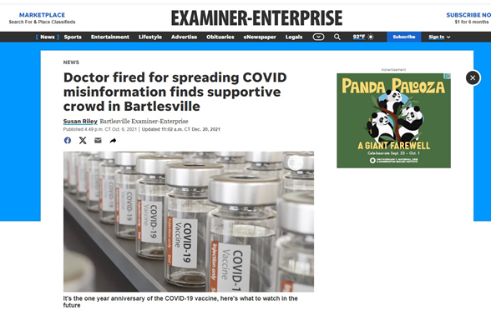
McCullough v. Gannett, con’t
Court found statements were not actionable because they were:
  Opinion
  True
  Not defamatory
  Not made with
  “actual malice”

Slide 26
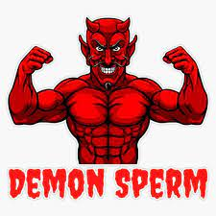
Examples of ideological libel suits
Immanuel v. Cable News Network, 618 F. Supp. 3d 557 (2022)
  Plaintiff doctor promoted hydroxycholoroquine as a COVID treatment despite lack of evidence of efficacy
  CNN accurately reported her false claims
  And that she claimed scientists were using “alien DNA” and “mixing human beings with demons”
  And that incubuses were impregnating women in their sleep

Slide 27
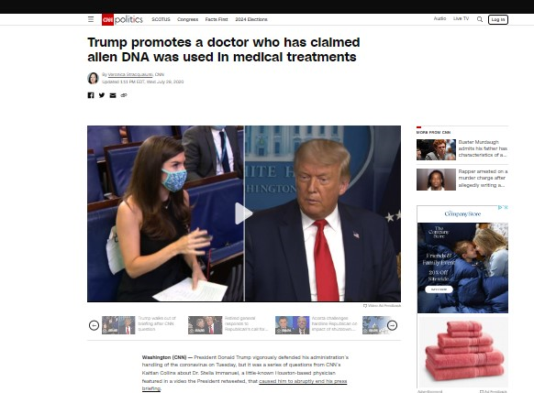
Immanuel v. CNN, con’t
The court dismissed, saying CNN’s statements:
  Accurately quoted Immanuel’s statements
  Were opinions expressed by other experts
  Were not made with actual malice

Slide 28
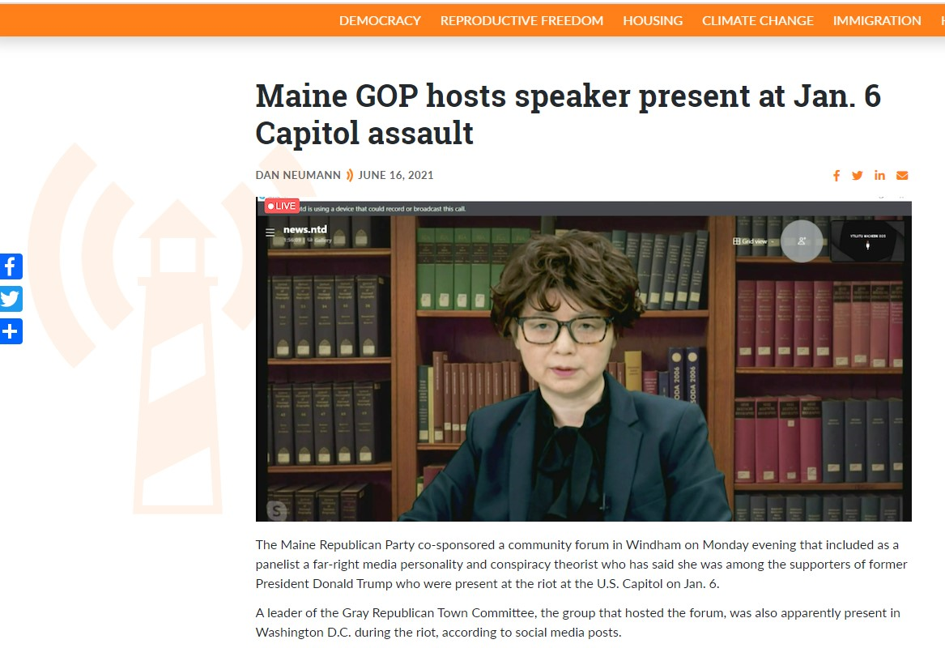
Examples of ideological libel suits
Cheng v. Neumann, 51 F.4th 438 (1st Cir. 2022)
  Plaintiff is exec with Epoch Times
  Sued over article accurately reporting her statements that she was at the Capitol on Jan. 6, 2021
  Trial & appellate courts
  rejected her claims of
  defamation by implication

Slide 29
How to mitigate the risk
Be alert to people making bogus claims who have nevertheless threatened to sue or sued
Be precise in reporting what people say and what their critics say
Take advantage of the fair report privilege
Be fair, and be respectful – feelings of being dismissed or ignored can spur litigation

Slide 30
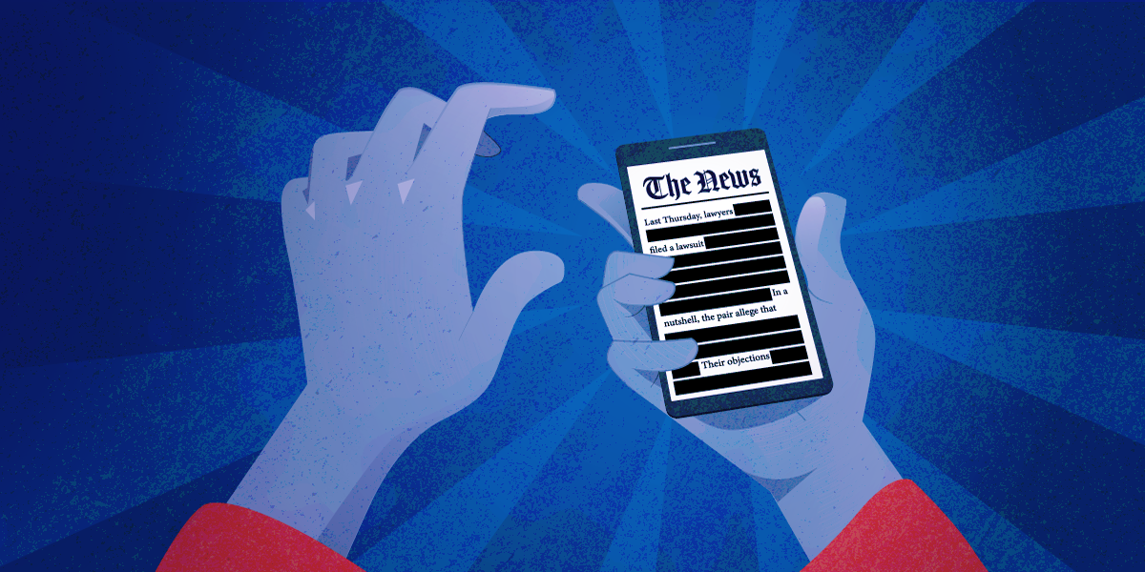
Whither Actual Malice?
A few judges have made headlines by questioning the First Amendment protections afforded by New York Times v. Sullivan
Are those protections in danger?

Slide 31
The Sullivan Standard
In Sullivan, the Supreme Court held that First Amendment protections for speech apply in defamation lawsuits
Public officials and public figures must prove the author of allegedly defamatory speech acted with “actual malice”
  Which is not ill will or spite, but rather:
    Knowledge of falsity or a subjective awareness of probable falsity

Slide 32
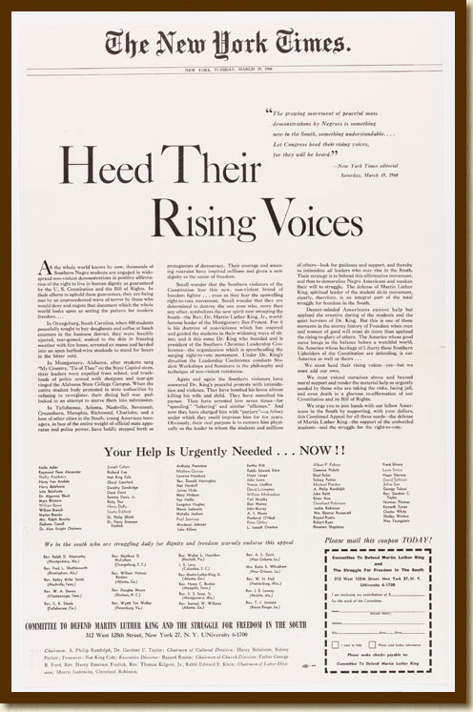
The First Amendment gives public discourse “breathing space” by requiring fault in defamation actions
New York Times Co. v. Sullivan, 376 U.S. 254 (1964)

Slide 33
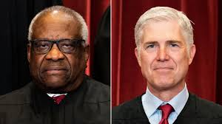
The attack on Sullivan
In recent years several prominent judges have argued that Sullivan should be overturned
Most prominent among them: Supreme Court justices Clarence Thomas and Neil Gorsuch

Slide 34
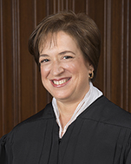
Reports of Sullivan’s death are greatly exaggerated
While Thomas’s and Gorsuch’s views are concerning, they do not appear to have support among their fellow justices
This June, in Counterman v. Colorado, Justice Kagan, writing for a 6-3 majority, described the state of mind required for a conviction for true threats
  With a favorable reference to Sullivan

Slide 35
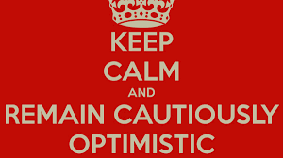
Cautious optimism: Counterman
Justice Thomas was the only dissenting justice to criticize the reliance on Sullivan in Counterman
Justice Amy Coney Barrett also dissented but didn’t join Thomas’s criticism of the actual malice standard
Justice Gorsuch
joined the majority

Slide 36

Questions?

